Slide 1


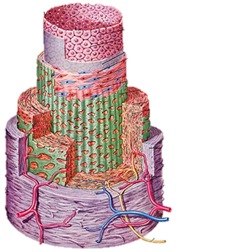
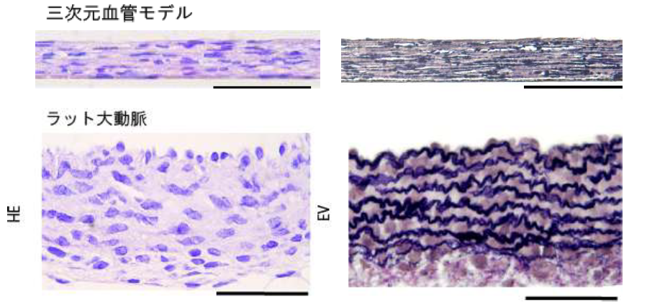
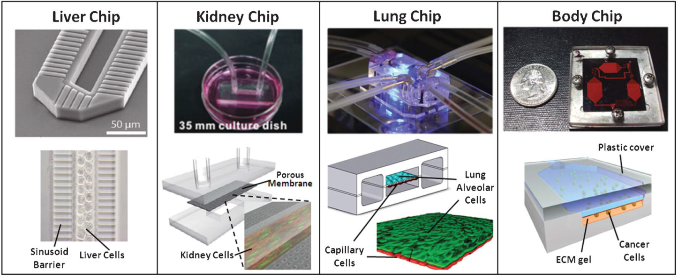
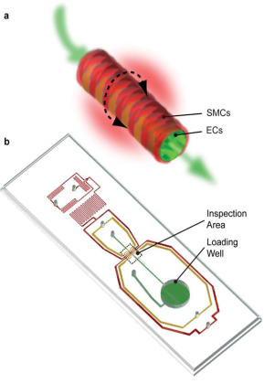
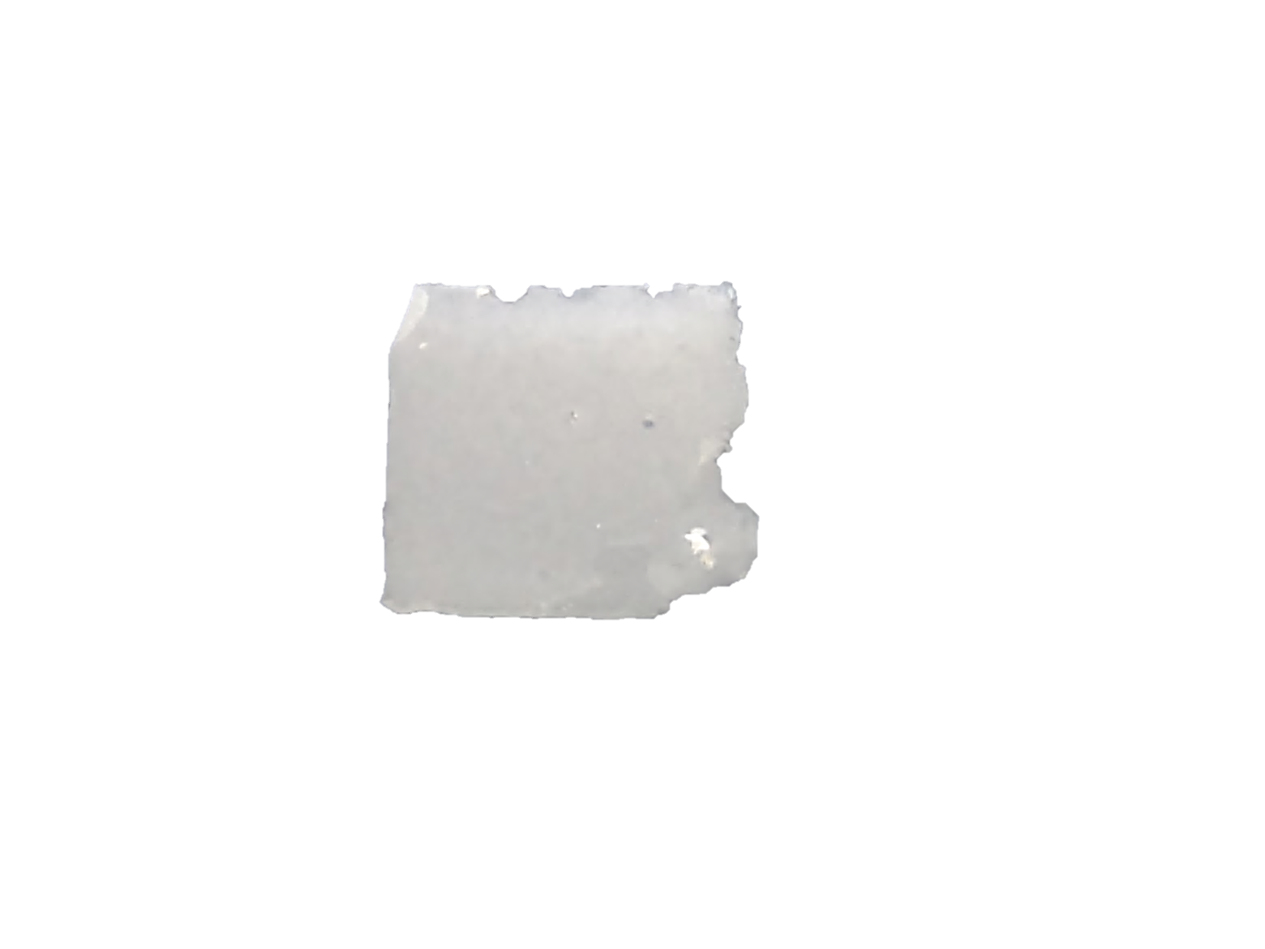
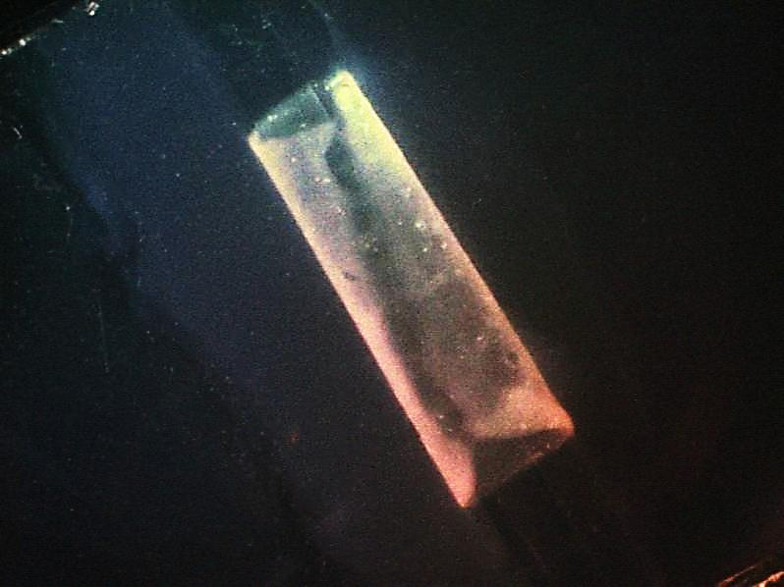
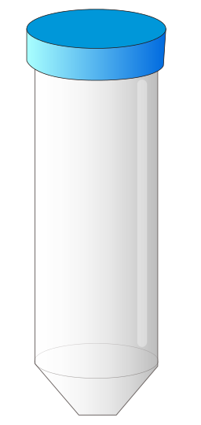
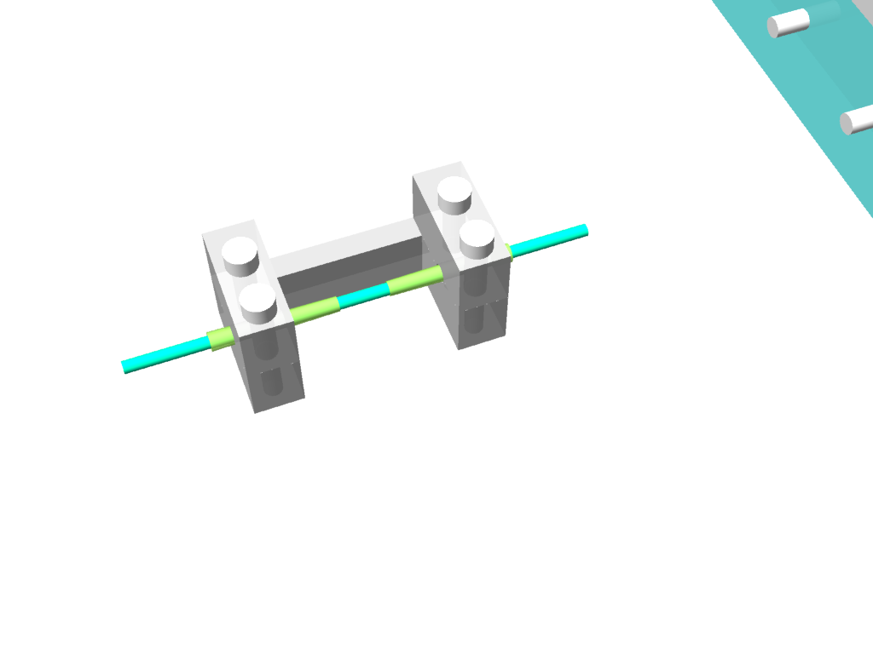
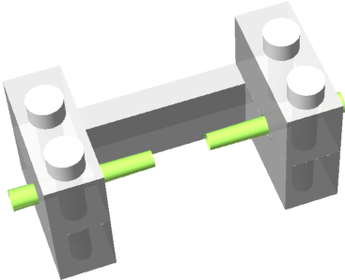
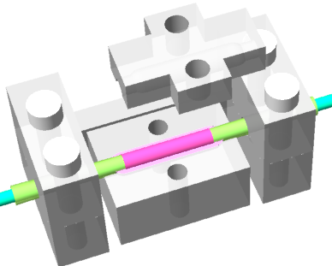
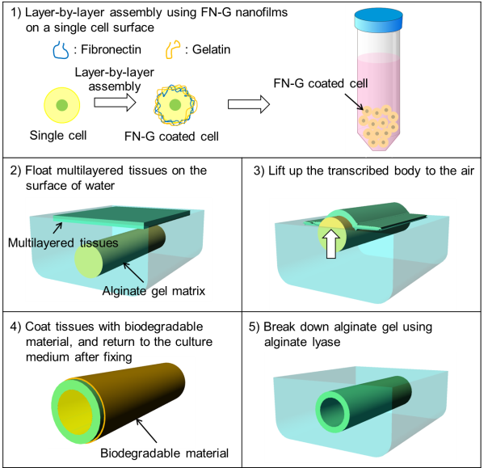
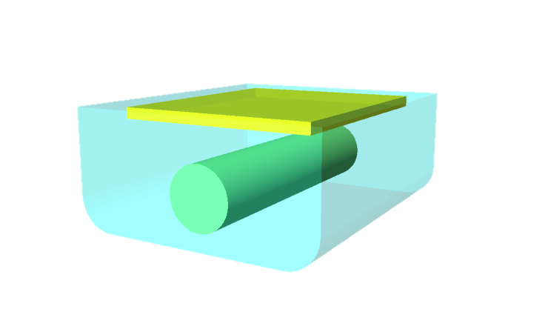
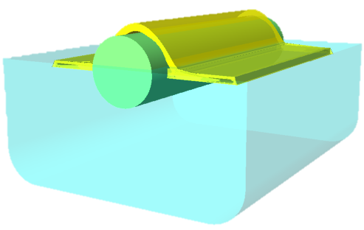
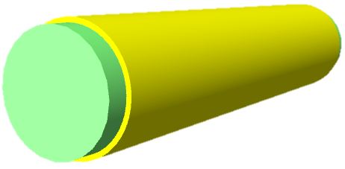
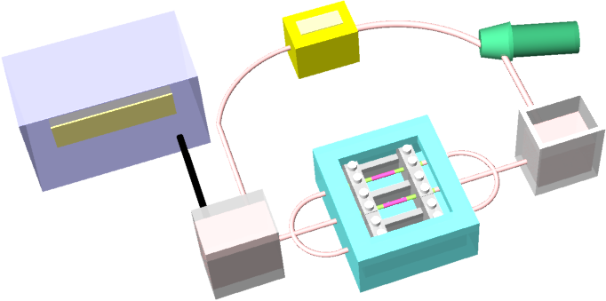
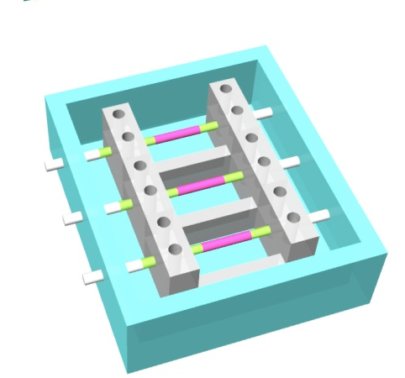
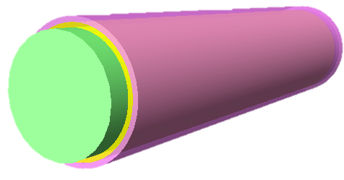
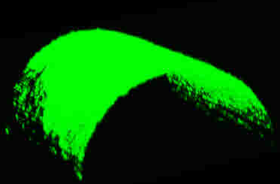
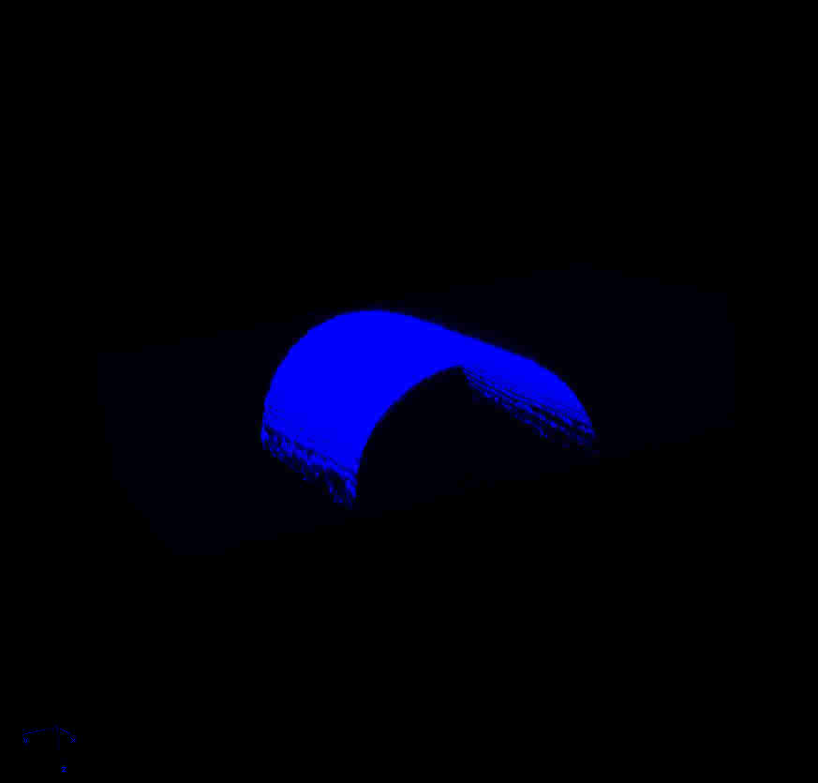
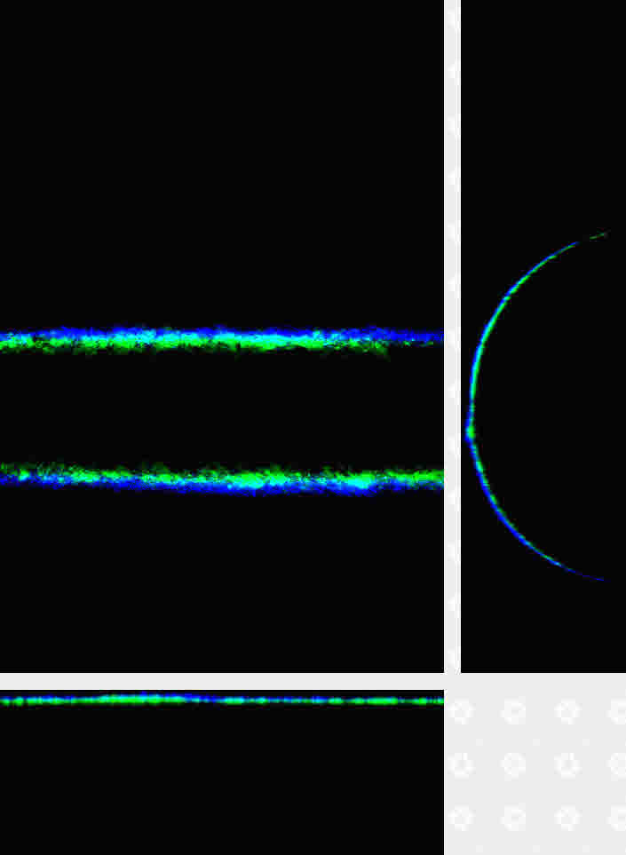
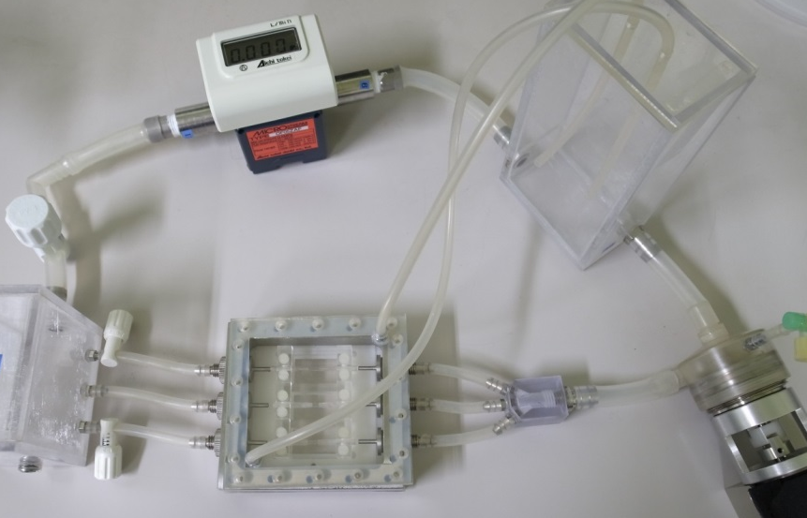
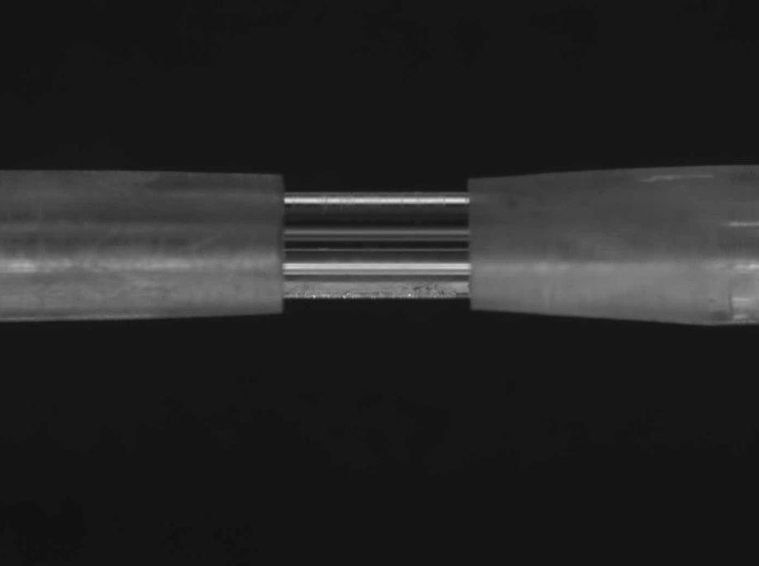
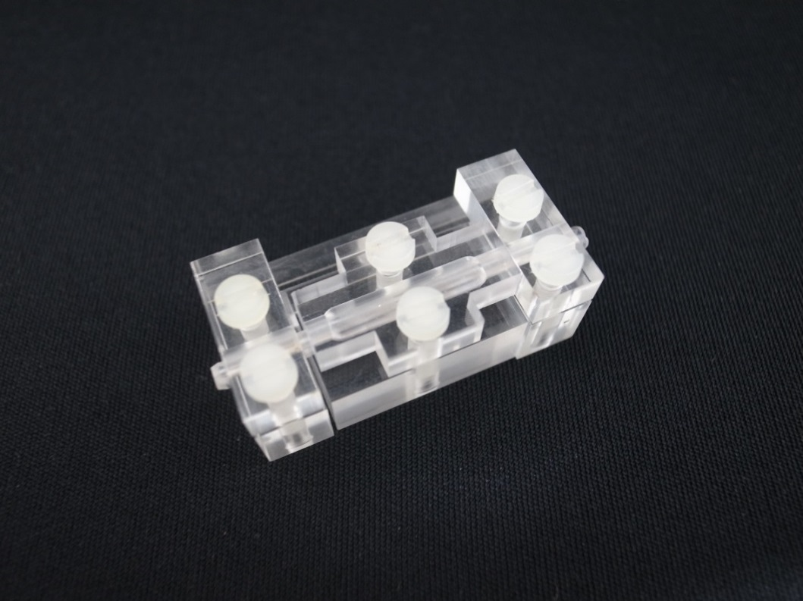
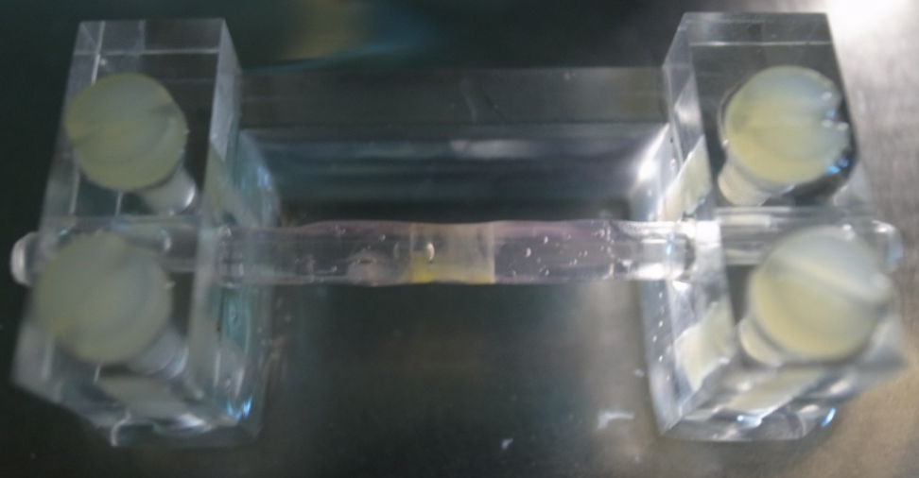
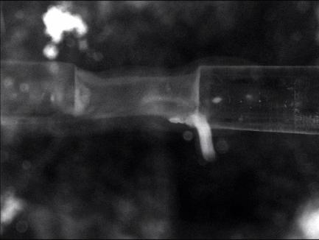
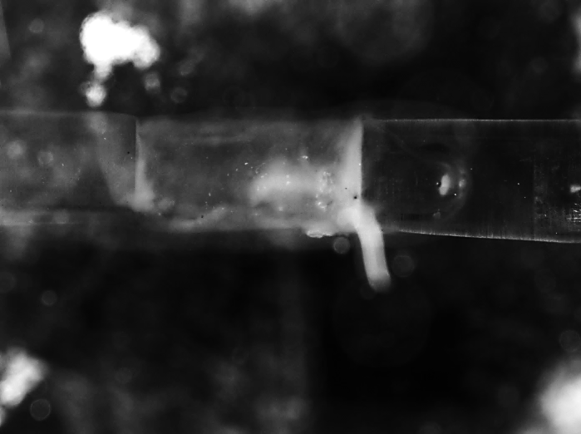

Circulatory Culture System for Multilayer-structured Tubular Tissues
¹Yuka Yamagishi, ¹Taisuke Masuda, ¹Natsuki Takei, ²Michiya Matsusaki,
²Mitsuru Akashi, and ¹Fumihito Arai
Nagoya University, 2. Osaka University
Connecting tubular tissue to the artificial system!!
Abstract: In this research, we proposed a microfluidic chip to pretreat the samples for genetic analysis of infectious viruses. The microfluidic chip has the following three functions; (1) Virus purification by hydroxyapatite-packed microcolumn, (2) Viral RNA extraction by silica-packed microcolumn, and (3) Capture of the targeted virus genome by PNA-immobilized glass substrate. Each function has been demonstrated separately using microfluidic chips.
Abstract: We proposed a 3D assembly technique and a circulatory culture system. We succeeded in fabricating multilayer-structured tubular tissues similar to blood vessels and connecting these tubular tissues to the artificial system. Also tubular tissues are circulated and evaluated with the proposed circulatory culture system. These results show that this system could be potentially useful for creating in vitro simulators for drug efficiency evaluation and operative training.
Background
Biomimetic 3D tubular tissue models
Purpose
Elastic fiber (rat)
Liver Chip
Kidney Chip
Lung Chip
Artery Chip
Connection
Soft and weak
tubular tissues
Circulation
Ref: U. Yokoyama
Organs on a chip
Sheet-like multilayered tissue
Tubular tissue
・ Connection of tubular tissues with high cell density
to the circulatory culture system
・ Circulation of tubular tissues
S. S.. Bolz et al.,
Lab on a chip
(2010)
3 mm
1 mm
D. E. Ingber et al., Lab on a chip (2010)
Concept
Fabrication of multilayer tubular tissues
Connection & Circulation of tubular tissues
1)
5)
Supporting body
6)
Assistive jig
: Fibronectin
: Gelatin
FN-G coated cell
Tubular tissue
Layer-by-layer
assembly
Single cell
FN-G coated cell
Cell accumulation
Collagen gel
2)
Fabricated multilayered tissue
3)
4)
7)
Centrifugal pump
PC
Mechanical
stimulation unit
Flow
Multilayer structured
tissue
Flow meter
Pump
Chemical
stimulation unit
O₂
(NO)
Pressure
sensor
Reservoir
Culture unit
CO₂, Temperature
Supporting body
Pressure sensor
Culture chamber
Camera
Observation
Cross section
Experiments
Sterilization
is available.
Supporting body
1st multilayered tissue
2nd multilayered tissue
100 μm
Glass capillary
Flow meter
Reservoir
3 mm
1 mm
1st multilayered tissue
Pressure sensor
Centrifugal
pump
Assistive jigs
100 μm
Green is stained with PKH67, Blue is stained with DAPI
2nd multilayered tissue
Culture chamber
A total of 20 sheets
50 μm
10 mm
Experiments
Connection & Circulation
Evaluation
6
4.5
3
1.5
0
300 Pa
u : Stretch[mm]
v : Poisson‘s ratio (0.49)
p : Inner pressure [Pa]
r : First diameter [mm]
t : Thickness [mm]
E : Young‘s modulus [Pa]
Before flow
Flowing
1 mm
Pulse flow
Pressure[×10²Pa]
Evaluation
[rpm]
1 cycle
Max
2 sec
Min
Pulse flow
Pump rotation rate
1 sec
3 mm in diameter
5 mm in length
5 mm
1 sec
Time [sec]
1 mm
Conclusions
Tubular tissue
Thickness : 60 μm,
Stretch : 125 μm
Thin cylinder model
u : Stretch
Multilayered tissue
1. The tubular tissue was successfully fabricated.(20 Sheets, High cell density, Non-wrinkle)
2. The soft and weak tubular tissues can be connected to the system.
3. The developed system has ability to simulate the tubular tissues in the circulation.
Collagen gel
Young’s modulus
of tubular tissues
: 130±20 kPa
Medium
t : Thickness
p
Acknowledgements：
This work is partially supported by Scientific Research from Ministry of Education, Culture, Sports, Science and Technology (23106002) and the Nagoya University Global COE program for Education and Research of Micro-Nano Mechatronics.
References：
Y. Yamagishi et al., Proceedings of microTAS 2013, pp. 2025-2027, 2013.
Y. Yamagishi et al., Proceedings of MHS 2013, P2-10, 2013.
Contact Person：Yuka Yamagishi
E-mail: yamagishi.yuka@biorobotics.mech.nagoya-u.ac.jp,
URL: http://www.biorobotics.mech.nagoya-u.ac.jp/
TEL: 052-789-5220, FAX : 052-789-5027

